Slide 1
Retail Bank Management
Presented By:
Siddhanta Biswas
Kratika Vijaywargiya
Palak Bhatia
Abhishek Deb
Renuka Singh
Ahmmedali
R Sujith Reddy
Akshay Kadam

Slide 2
Project Overview
The Project provides the following features:-
manage savings and current accounts
to add customer
update and delete customer information
manage cashier transactions such as deposit, withdraw and transfer
view customer and account information and get account transaction information

Slide 3
Methodology Used: Agile
Agile software development is a conceptual framework for software engineering that promotes development iterations throughout the life-cycle of the project.
Scrum is an Agile S/w development method for project management which has been implemented here.
A Sprint is a set period of time during which specific work has to be completed and made ready for review.
User stories are short, simple descriptions of a feature told from the perspective of the person who desires the new capability, usually a user or customer of the system.

Slide 4
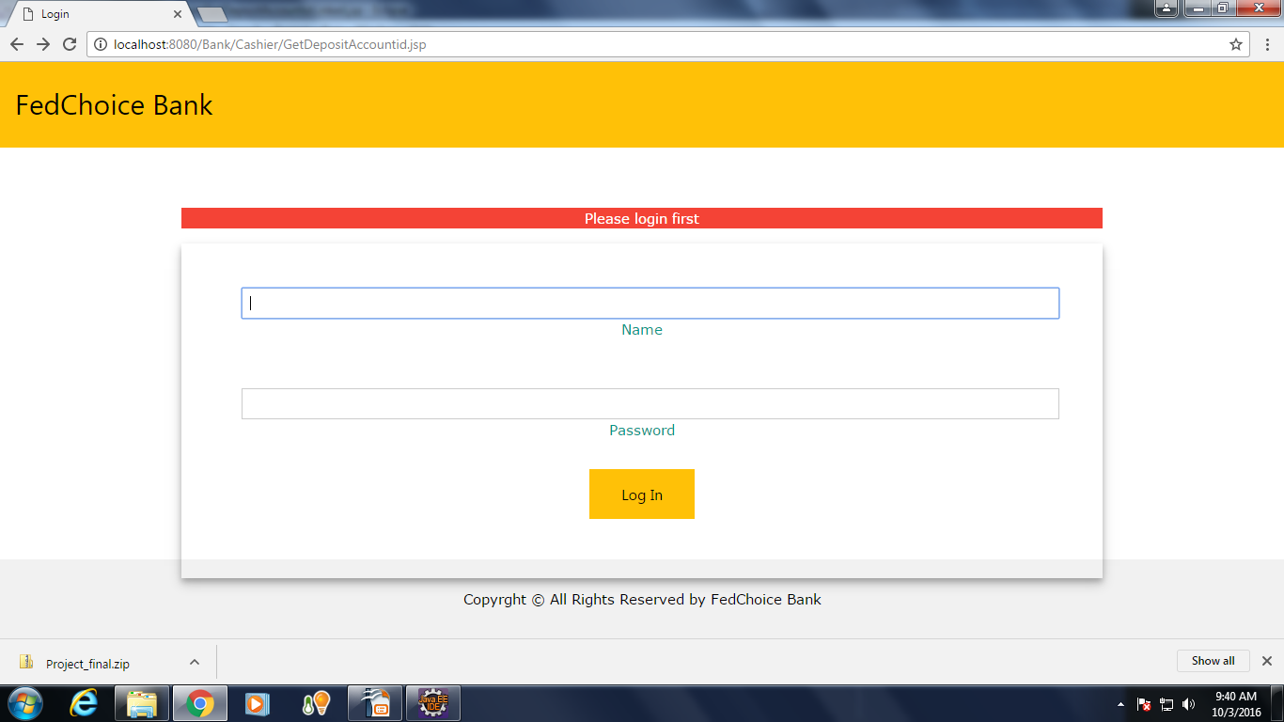
US001: Login Page
Offers secure system login for the bank employees.
To allow only bank employee to be able to login to
bank web site.

Slide 5
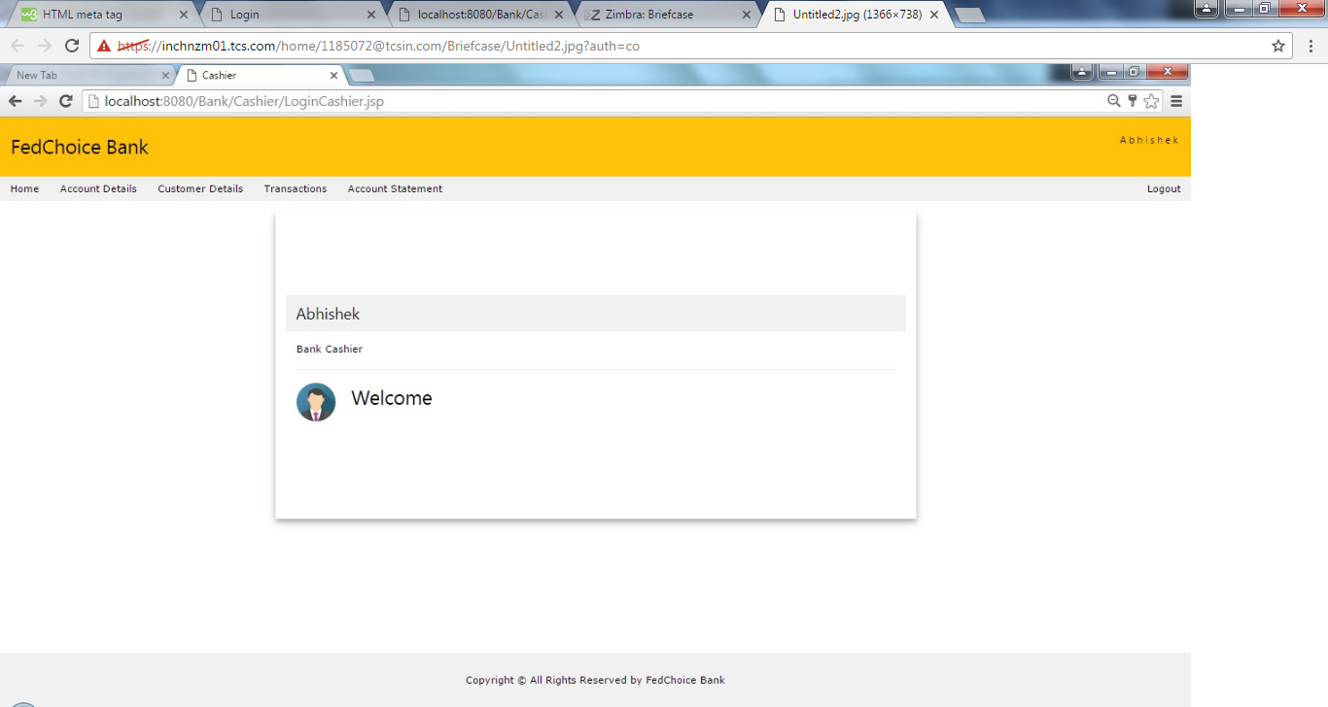
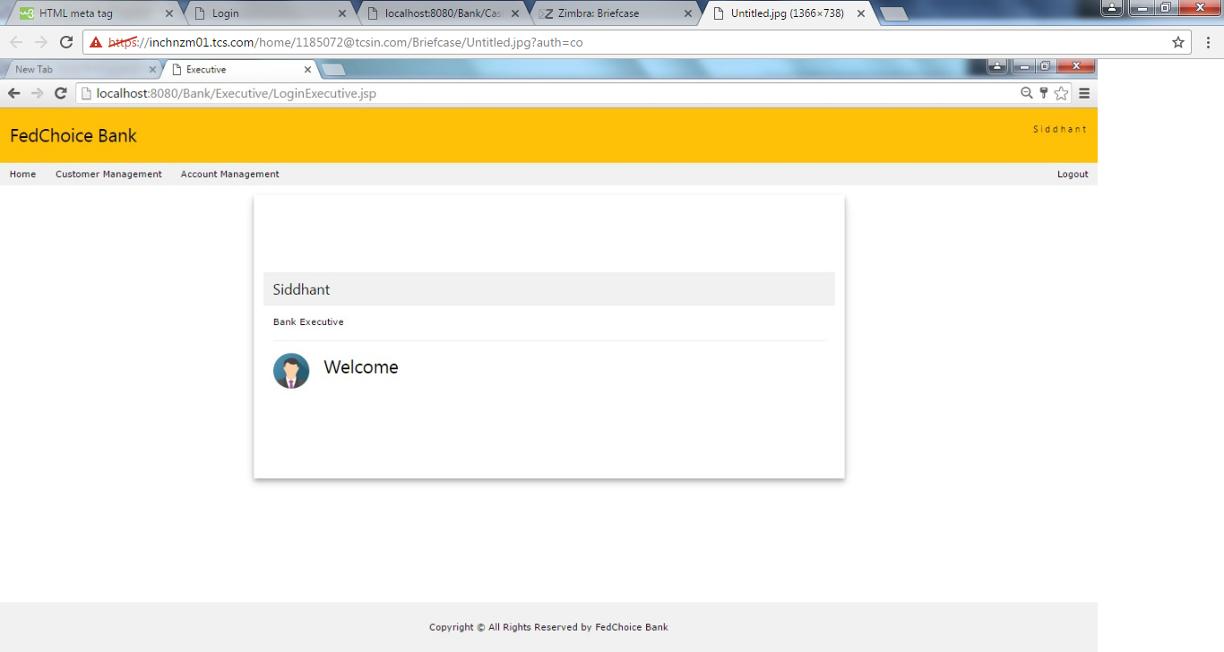
Home Screen for Cashier
Home Screen for Bank Executive

Slide 6
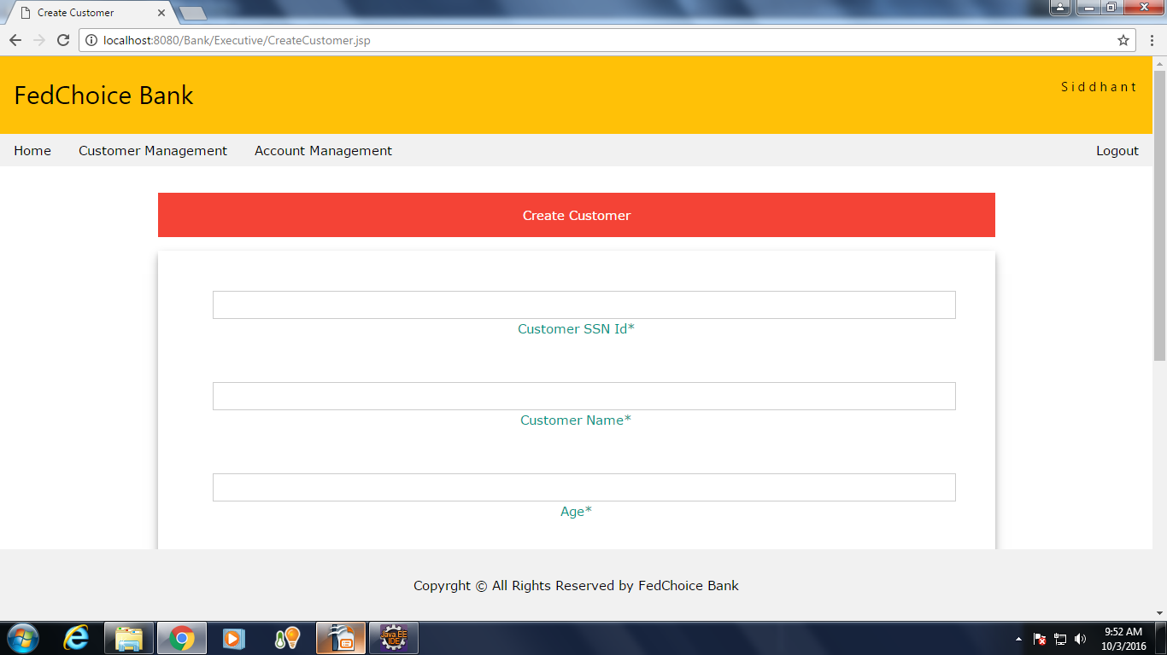
US002:Create Customer
To allow customer-account executive to
create new customer.

Slide 7
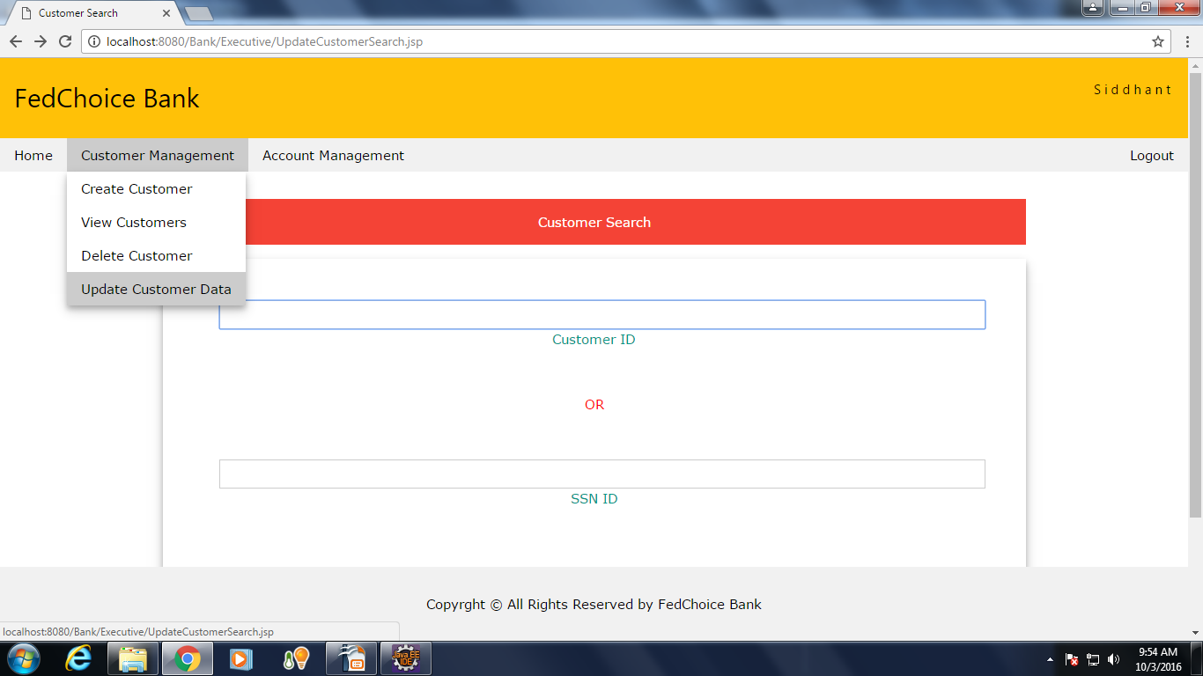
US003:Update Customer
It allows to edit existing customer information
and update customer information in the system.

Slide 8
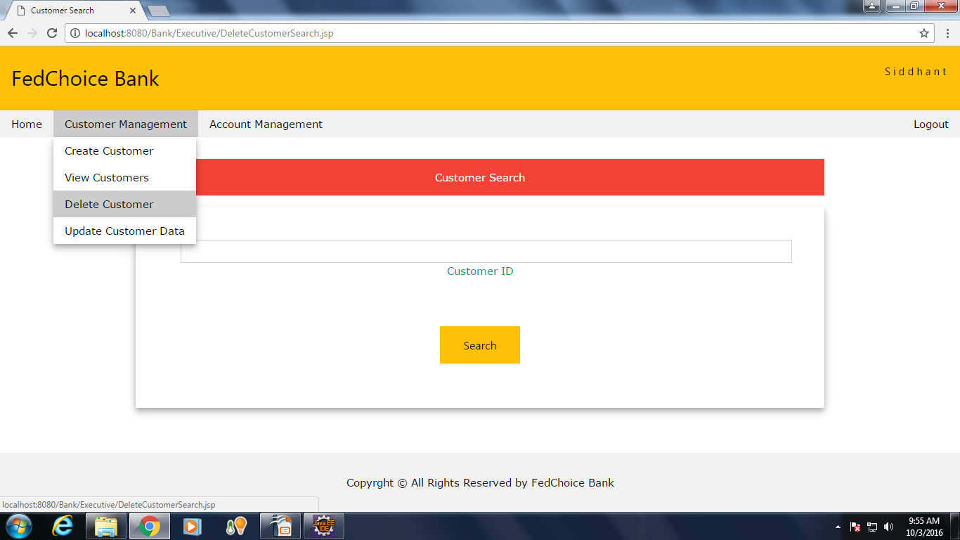
US004:Delete Customer
It allows to delete existing customer information from the system.

Slide 9
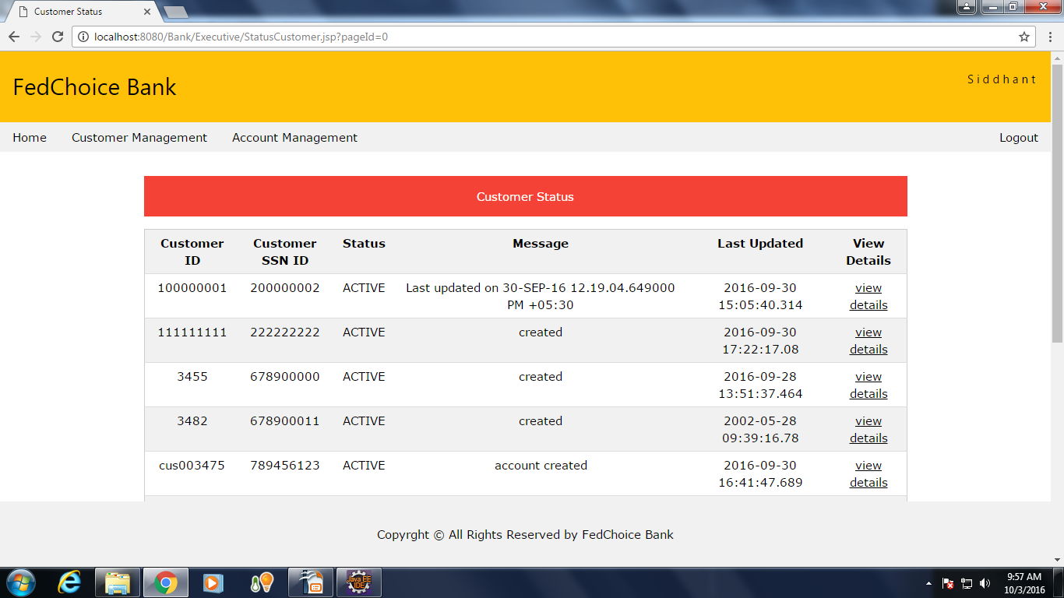
US005:Customer Status
It allows the customer-account executive to view the status of all the customers of the bank.

Slide 10
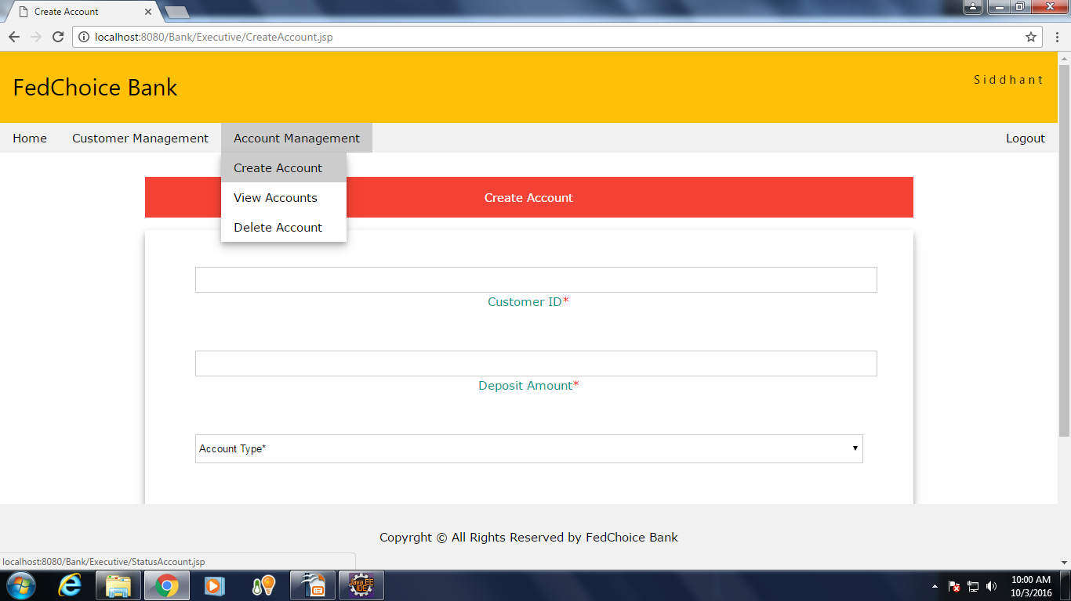
US006:Create Account
It allows the customer-account executive to be able to capture account details,so that a new bank account can be created for an existing customer .

Slide 11
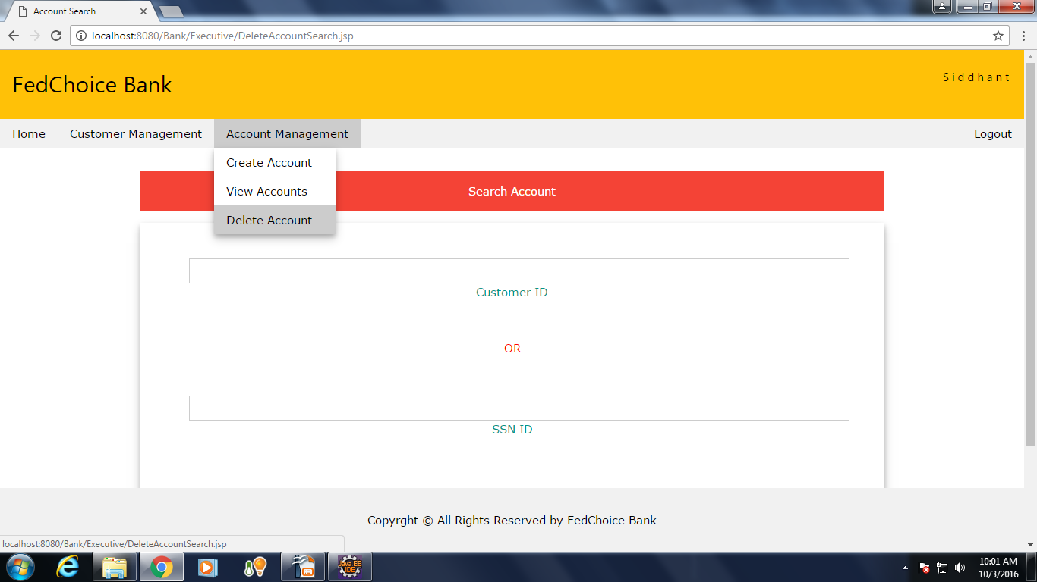
US007:Delete Account
It allows the customer-account executive to delete
an account of an existing customer.

Slide 12
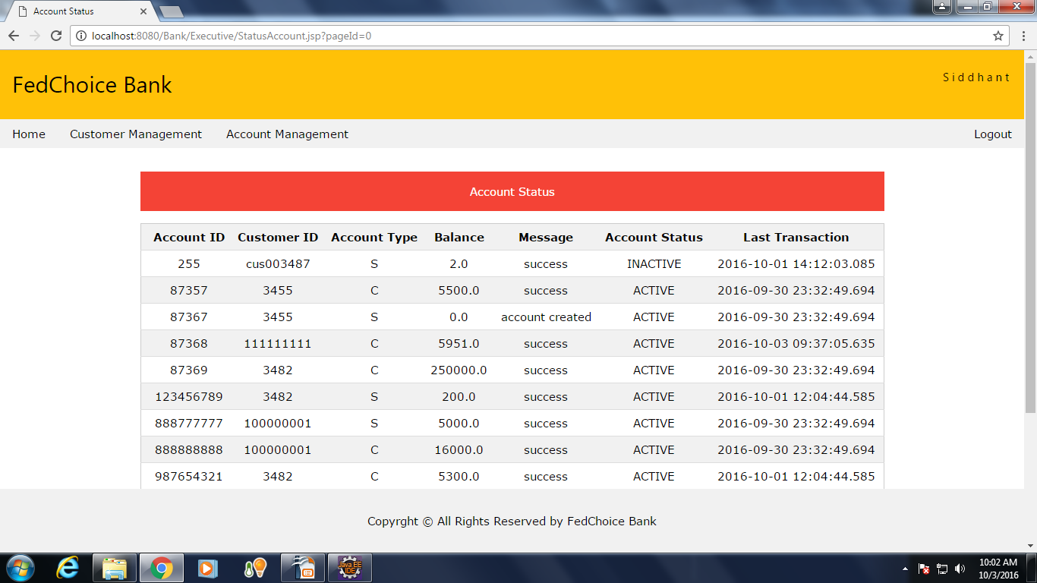
US008:Account Status
It allows the customer-account executive to view the status of all the accounts of the bank.

Slide 13
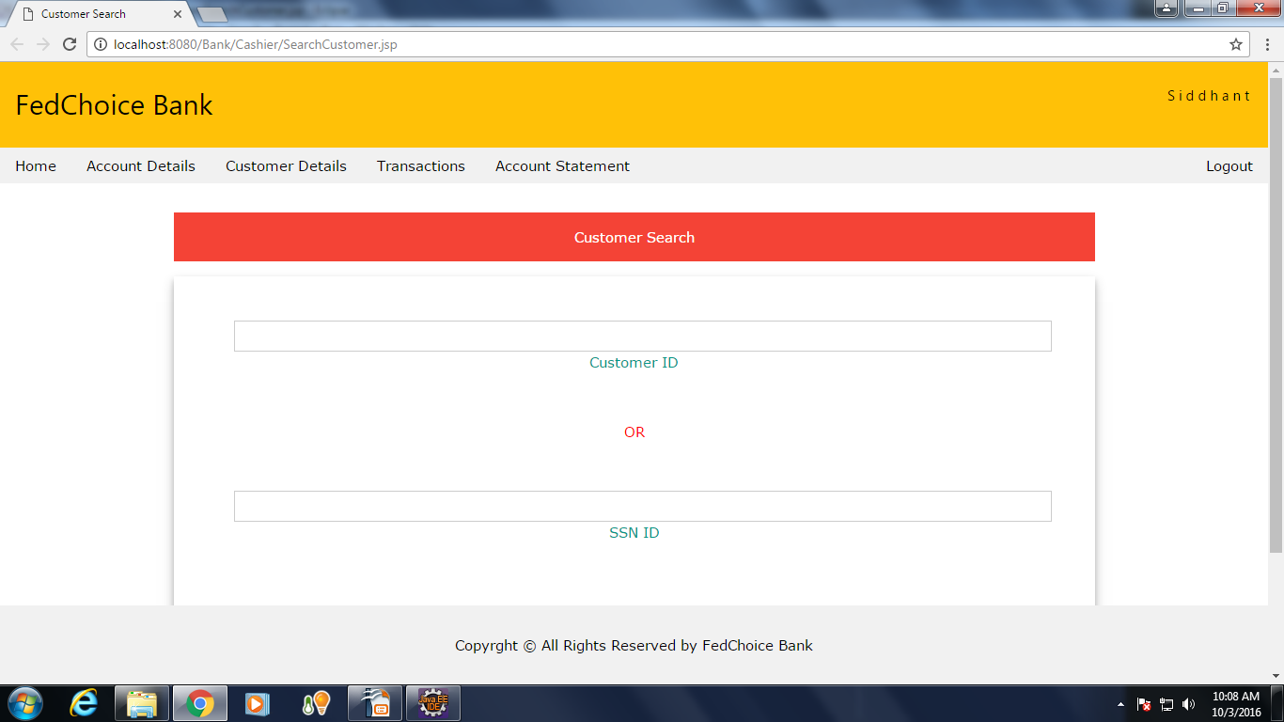
US009:Search Customer
It allows the customer-account executive to
search for a customer and view the details.

Slide 14
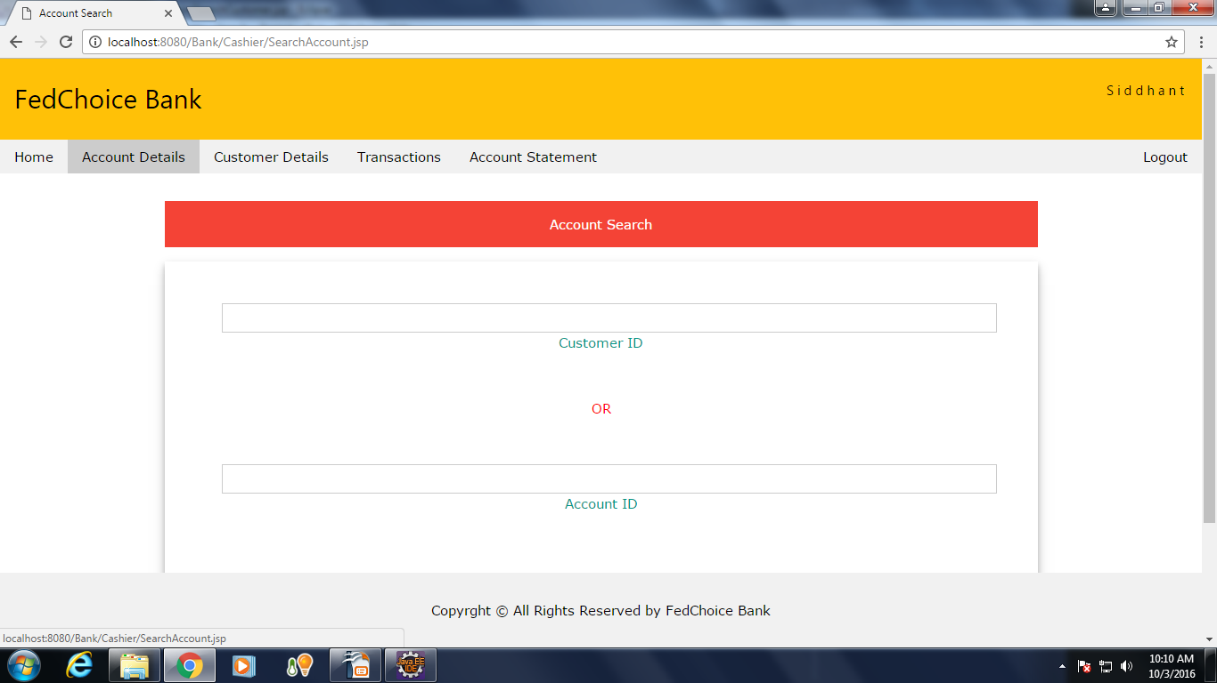
US010:Search Account
It allows the customer-account executive to search for a bank account of a customer and view its details.

Slide 15
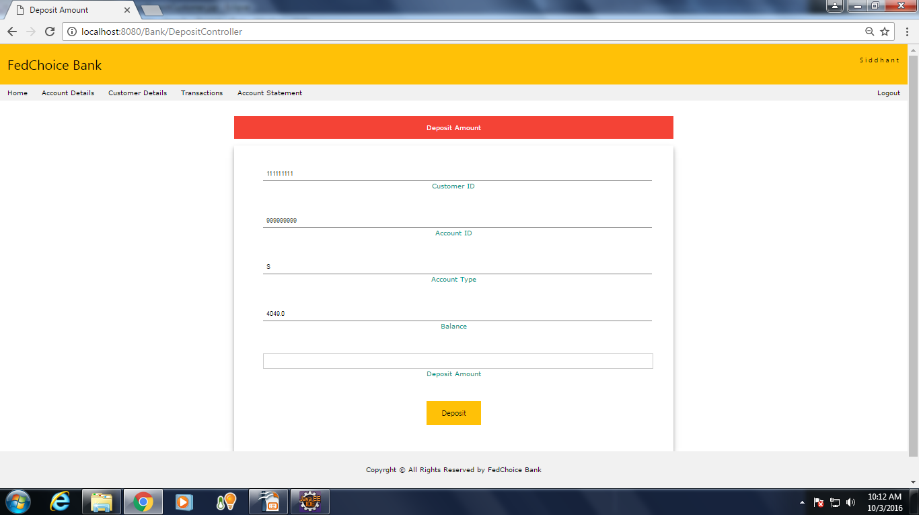
US011:Deposit Money
It allows the Cashier/ Teller to deposit money into a customer's account.

Slide 16
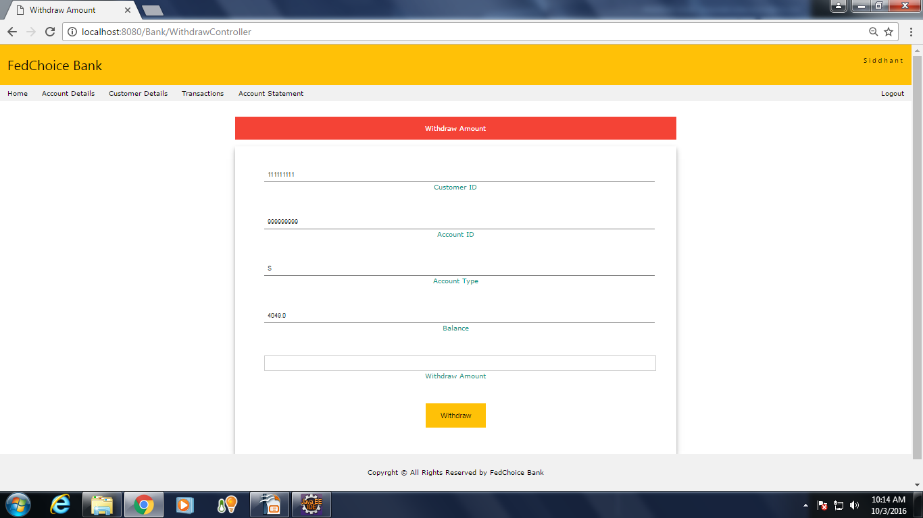
US012:Withdraw Money
It allows the Cashier/ Teller to withdraw money from a customer's account.

Slide 17
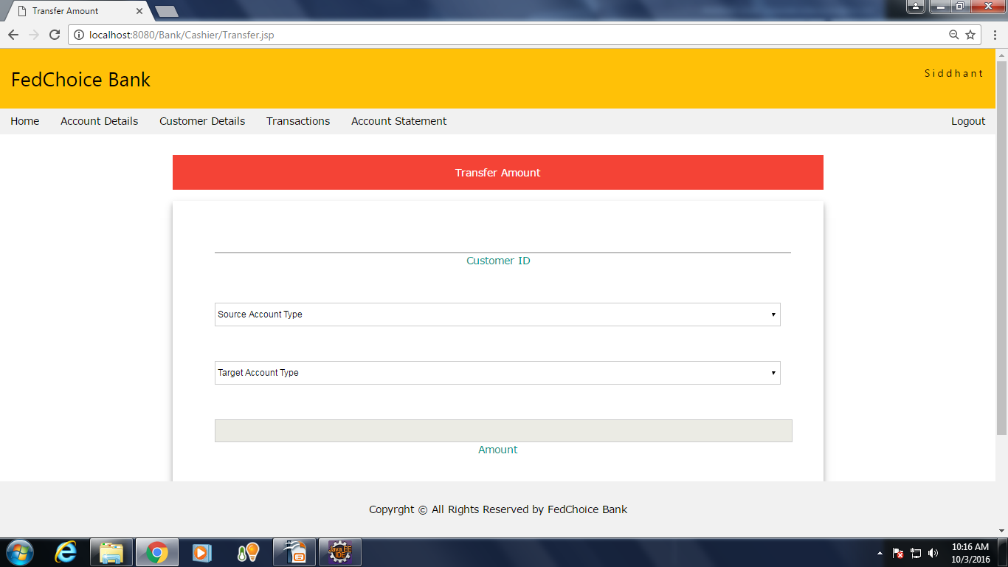
US013:Transfer Money
It allows the Cashier/ Teller to transfer money from a customer's account to same customer's other account.

Slide 18
US014:Print Account Statement
It allows the Cashier/ Teller to print an account statement.
It provides option to get hard copy of the statement.

Slide 19
Thank You

